Slide 1

DEVELOPMENT OF A PORTABLE INCUBATOR FOR THE DETECTION OF COLIFORM IN WATER USING IOT
Olonisakin David Akolade, Oguibe Favour Oziomachukwu, Omoruyi Osemwegie
Department Of Electrical and Information Engineering
Covenant University
Ota, Ogun State, Nigeria
oguibe.favour@stu.cu.edu.ng
olonisakin.david@stu.cu.edu.ng
osemwegie.omoruyi@covenantuniversity.edu.ng

Slide 2
1. INTRODUCTION
The research was inspired by the need for precise and trustworthy techniques for identifying waterborne infections, especially coliform bacteria, in places with few laboratory facilities. Coliform bacteria are used as a quality gauge for water and are a sign that potentially dangerous diseases may be present. Ensuring the availability of safe drinking water stands as a key priority in public health efforts because it is intimately related to human health. Consuming water that contains hazardous chemicals or pathogenic organisms has a major influence on one's health^{[1]}.

Slide 3
INTRODUCTION (continued)
The lack of low-cost, simple-to-use, and accurate techniques for remote water monitoring and coliform detection is the key issue driving this research. Due to difficulties with transportation, sample storage, and inadequate laboratory facilities, traditional laboratory-based approaches are frequently not practical in remote places. Thus, the creation of a mobile incubator for coliform detection could be the answer to this issue. The project is aimed towards developing a portable incubator that can quickly and accurately detect coliform bacteria in water using an approach that is both affordable and simple to use. The issue of restricted access to laboratory facilities for water monitoring and coliform detection can be resolved by the portable incubator, especially in distant locations

Slide 4
2. Overview of Existing Water Quality Detection Methods
Diverse techniques for identifying waterborne contaminants have been developed and put to use in the effort to guarantee safe and clean drinking water. The merits and demerits of water quality detection technologies are highlighted
a. Culture-Based Methods: To detect coliform bacteria and other microbes using traditional methods, water samples are cultured on specific media. These procedures deliver precise findings, but they frequently call for specialized facilities, knowledgeable staff, and protracted incubation times. Additionally, the requirement for sterile conditions may restrict their applicability in places with limited resources.

Slide 5
b. Membrane Filter Method: This technique entails passing a water specimen through a sterilized, bacteria-retaining 0.45-millimeter pore filter. Typical colonies on the filter are then counted after the filter has been cultured on a selective medium. Although this approach is more sensitive than direct culture, it still requires lengthy incubation times and poses a danger of cross-contamination.
c. Enzymatic Method: Coliforms possess the enzyme -galactosidase, which produces acids and gases at their optimum growth temperatures of 35 to 37 degrees Celsius (°C). Color or fluorescence is produced when a certain enzyme breaks down a chromogenic or fluorogenic substrate. These chemicals have been utilized to identify the presence or activity of specific enzymes in water^{[2]}.

Slide 6
3. Design of Portable Incubator
The design was done with an ESP 32 microcontroller for data transmission of the sensor reading: LDR, DHT11, PTC heater controlled by a relay to BLYNK for visualization and a 12v Dc Power supply unit to power the incubator. The LDR is used to detect turbidity changes in water being sampled. See next slide for illustration

Slide 7

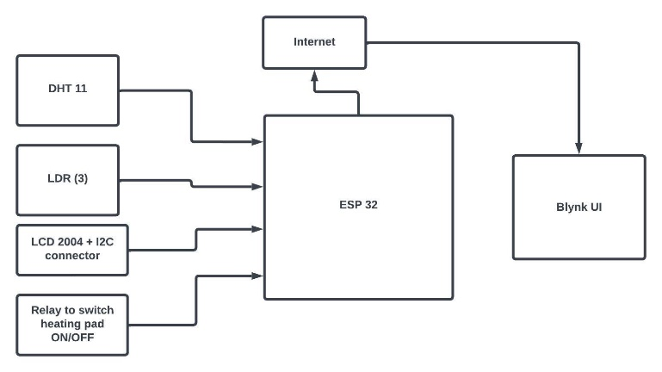
Block Diagram SHOWING INTERACTION OF COMPONENTS OF THE PORTABLE INCUBATOR

Slide 8
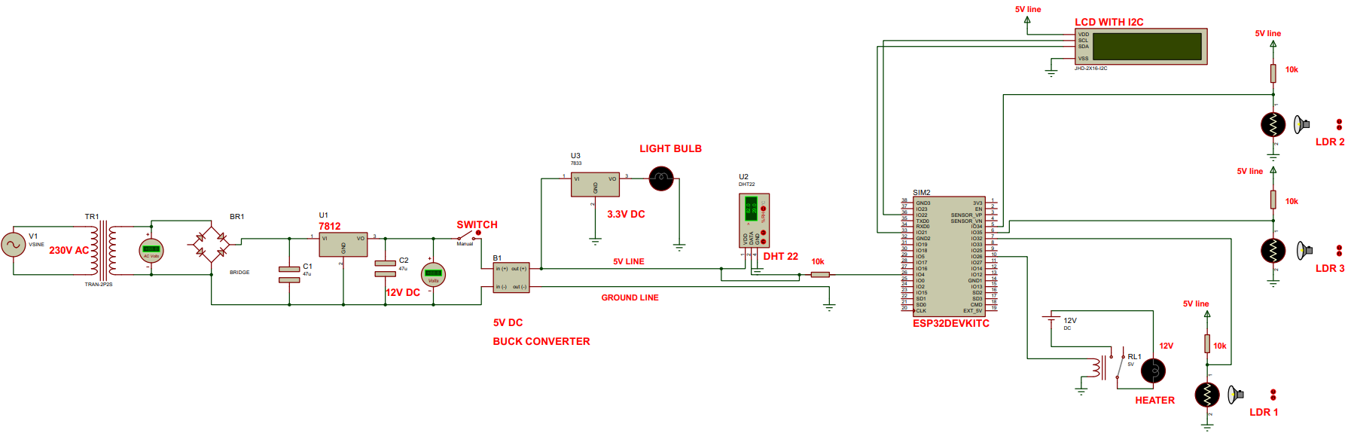
Circuit diagram for portable incubator

Slide 9
4. Implementation and Testing
For system implementation, the ESP32 is selected as the controller of choice. The testing phase comes after the actual system has been implemented based on the design specifications.

Slide 10
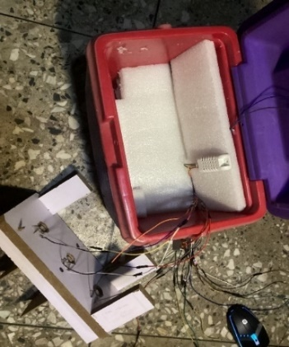
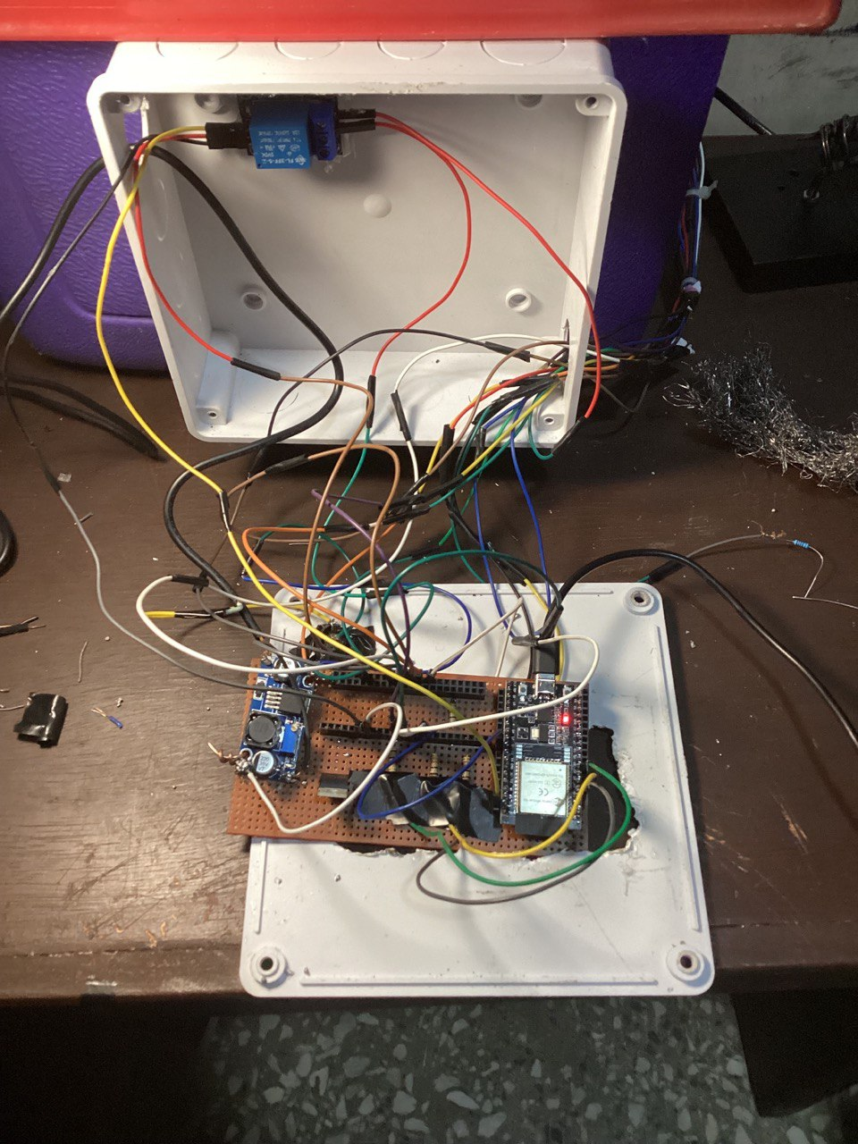
Building the portable incubator

Slide 11
4. Implementation and Testing (continued)
Each LDR analog resistance reading was taken with the LED on, and with the LED off. The resistance taken with the LED off is to obtain the max resistance value of each LDR. For our testing, 100ml of the water sample is added to the powder samples which come in pre-weighted bottles. These samples are then incubated for 16 hours in our incubator. For testing and calibration purposes, samples of coliform bacteria were gotten from microbiology laboratory and added to our water samples to ensure our water is contaminated with coliform bacteria, therefore leading to the subsequent color change which we need as it indicates the presence of coliform bacteria in the water sample tested. After 16 hours, the water sample infected with coliform bacteria changed color from a goldish color to a dark greenish color with a lot of cloudiness, whereas a water sample which is uninfected with coliform bacteria remains golden in color, and uncloudy after 16 hours of incubation.

Slide 12
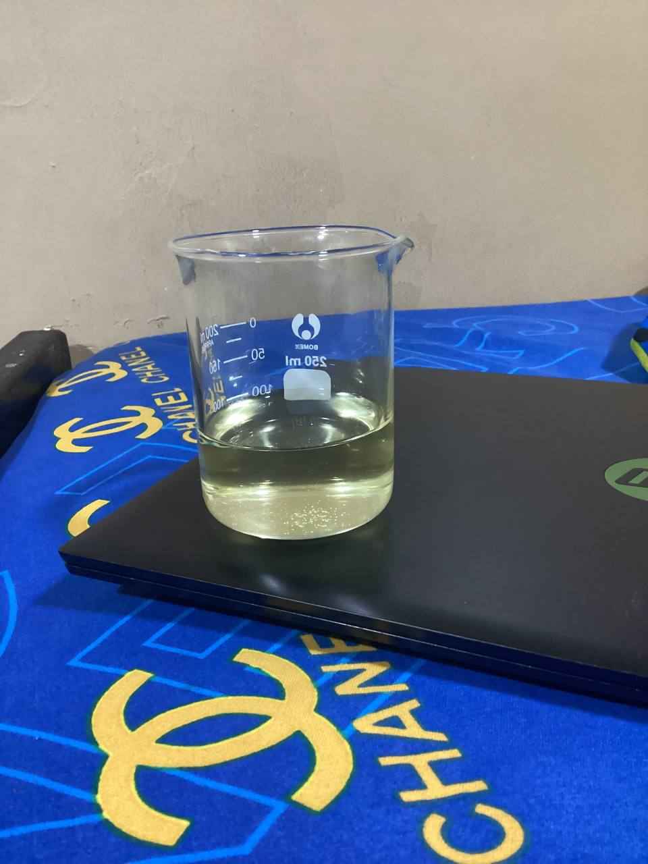
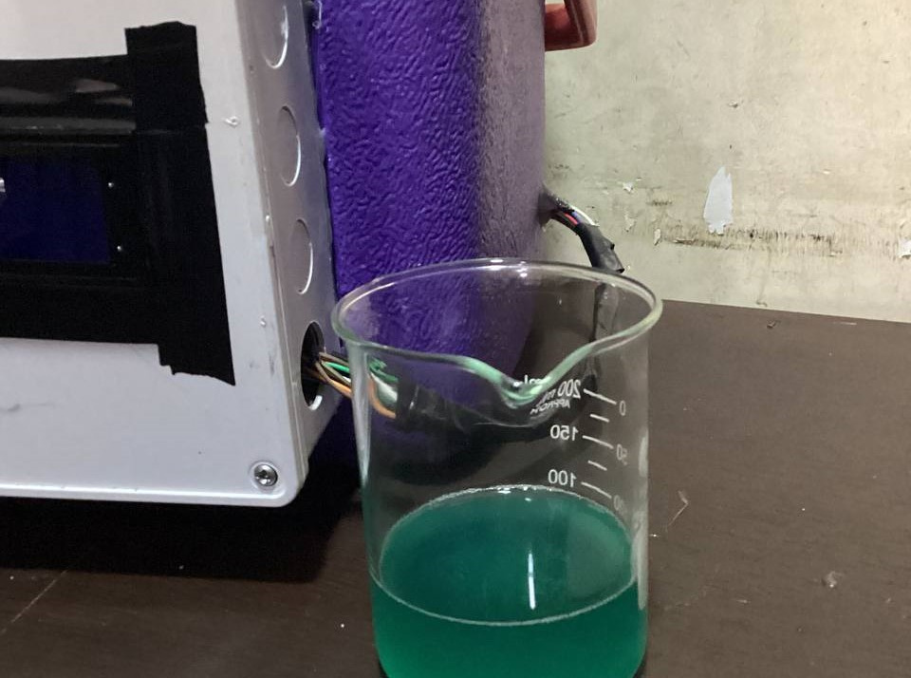
WATER SAMPLE changes from golden yellow hue to dark green AFTER 16 HOURS OF INCUBATION

Slide 13
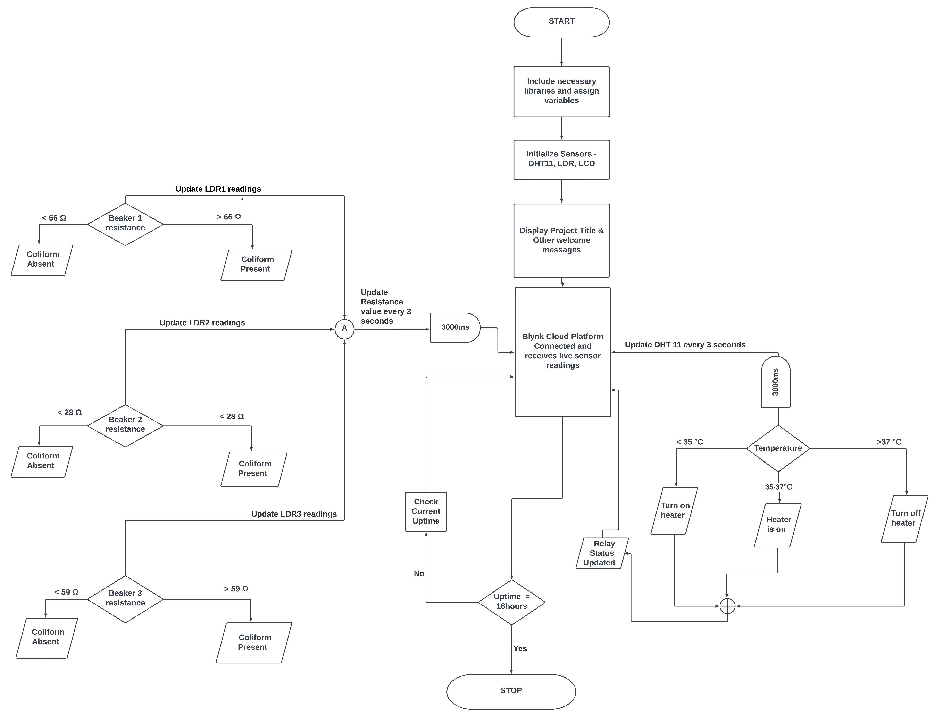
FLOWCHART SHOWING INTERACTION OF PORTABLE INCUBATOR

Slide 14
Advantages of Portable Incubator
The use of IoT allows for remote data transfer and continuous monitoring, which minimizes response times and the requirement for physical presence.
The incubator's portability makes it possible to conduct testing locally rather than having to send samples to other cities or countries for analysis.
The design intends to streamline usage, enabling testing at the community level and accessibility to non-specialist users.
The suggested incubator aims to provide a more affordable option for monitoring water quality by avoiding the need for costly laboratory facilities.

Slide 15
Recommendations for further improvement
Further improvements will come in the way of:
Enhancing LDR calibration: The accuracy and sensitivity of coliform detection may be increased by further calibrating and refining the LDR sensor. More exact readings can be achieved by investigating sophisticated calibrating procedures and using data processing algorithms
Optimize heating system and insulation: To increase temperature uniformity inside the incubator, ongoing improvements to the heating system and insulation materials should be made. This would guarantee accurate and repeatable results when detecting coliforms.

Slide 16
Recommendations for further improvement(cont’d)
Using a Swarm M138 Satellite Transceiver as the IOT chip: The Swarm M138 offers global coverage through satellite communication. This is especially helpful when placing the portable incubator in remote or difficult-to-reach locations where conventional cellular networks might not be present.
Alternative methods for color change detection: Although the incorporation of an LDR sensor was successful in detecting the color change suggestive of coliform growth, using other techniques such as cameras and computer vision could provide more information. These techniques might increase accuracy and efficiency since they can automatically analyze visual changes and capture them.

Slide 17
Conclusion
The effective design and execution of the portable incubator for the detection of coliform bacteria stands as a monument to innovation and advancement in the effort to improve water quality detection methods and encourage safe drinking water access. By utilizing cutting-edge technology and an innovative strategy for monitoring and preserving the public's health, this project has solved the shortcomings of conventional methods for detecting quality of water.

Slide 18
References
[1] “Coliform Bacteria and Drinking Water,” 2016.
[2] P. Pal, "Detection of Coliforms in Drinking Water and its Effect on Human Health - A Review," International Letters of Natural Sciences, vol. 17, pp. 122-131, Jun. 2014, doi 10.18052/www.scipress.com/ilns. 17.122.

